Slide 1
CSC 112: Computer Operating Systems Lecture XX Processes and Threads
Department of Computer Science,
Hofstra University
Acknowledgement: Lecture slides based on UC Berkeley CS 162: Operating Systems and System Programming

Slide 2
Review: Instruction Execution
Addr 2³²-1
R0
…
R31
F0
…
F30
PC
…
Data1
Data0
Inst237
Inst236
…
Inst5
Inst4
Inst3
Inst2 Inst1
Inst0
Fetch
Exec
Execution sequence:
Fetch Instruction at PC
Decode
Execute (possibly using registers)
Write results to registers/mem
PC = Next Instruction(PC)
Repeat
PC
PC
PC
PC
Addr 0

Slide 3
Concurrency
A “thread” of execution is an independent Fetch/Decode/Execute loop
a sequential instruction stream
Uni-programming: one thread at a time
MS/DOS, early Macintosh, Batch processing
Easier for operating system builder
Get rid concurrency by defining it away
Does this make sense for personal computers?
Multi-programming: more than one thread at a time
Multics, UNIX/Linux, OS/2, Windows NT/2000/XP, Mac OS X
Notes:
Program vs. Process:
A process is a running program:
I run emacs on lectures.txt, you run it on homework.java – Same program, different processes

Slide 4
Concurrency vs. Parallelism
Concurrency is from the application perspective
The application software consists of multiple threads of execution
Parallelism is from the hardware perspective
The hardware platform consists of multiple CPUs
A concurrent application can be executed on a single or multi-CPU hardware platform

Slide 5
The Basic Problem of Concurrency
Consider a concurrent application running on a single-CPU hardware platform
Must provide illusion to each application thread that it has exclusive access to the CPU
Each thread is unaware of existence of other threads
OS has to coordinate multiple threads

Slide 6
Multithreading
Th1
Th2
Th3
Th4
Th5
Time
How to provide the illusion of multiple CPUs with a single physical CPU?
Multiplex in time!
Each thread has a data structure (TCB, Thread Control Block) to hold:
Program Counter (PC), Stack Pointer (SP), Register values (Integer, Floating point…)
How switch from one thread to the next?
Save PC, SP, and registers in current TCB
Load PC, SP, and registers from new TCB
What triggers switch?
Timer, voluntary yield, I/O…

Slide 7
Two Types of Resources
CPU is an active resource that can be used by only one runtime entity (thread or process) at any given time
Can be multiplexed in time (scheduled)
Memory is a passive resource that can be shared among multiple runtime entities simultaneously
Can be multiplexed in space (allocated)

Slide 8
How to Protect Tasks from Each Other?
Protection of memory
Each task does not have access to all memory
Protection of I/O devices
Each task does not have access to every device
Protection of CPU
Use of timer interrupts to enforce periodic, preemptive switching between tasks
Must not be possible to disable timer from user code
(“Task” here refers to a runtime entity, can be either a thread or a process)

Slide 9
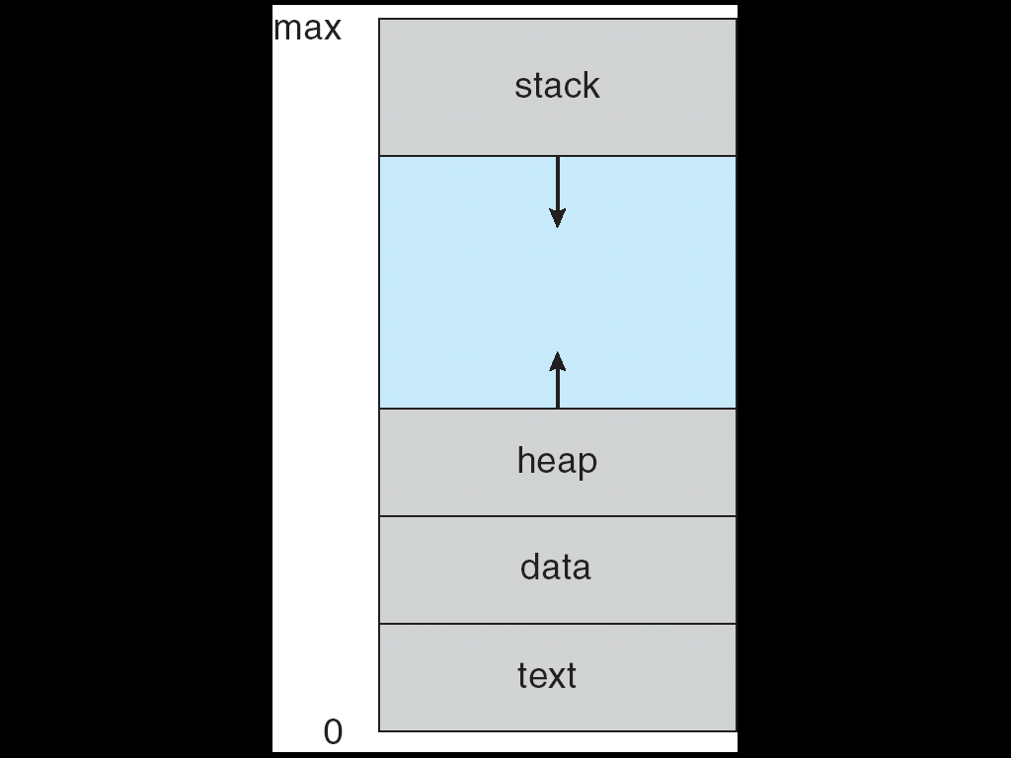
Review: Address Space
Address space ⇒ set of accessible addresses + state associated with them (contents of the memory addresses):
For a 32-bit processor there are 2³² = 4 billion addresses
Program Address Space

Slide 10

Review: a Process in Memory
int global = 0;
int main (int arg)
{
float local;
char *ptr;
ptr = malloc(100);
local = 0;
local += 10*5;
…..
….
foo();
…. /* return addr */
….
return 0;
}
Local variables
Return address
Dynamically allocated
Global variables
Program code
(“text” is also called “code”, referring to the
binary executable code)

Slide 11
Review: Execution Stack
A(1);
A(int tmp) {
if (tmp<2)
B();
printf(tmp);
}
B() {
C();
}
C() {
A(2);
}
A: tmp=1
ret=exit
B: ret=A+2
C: ret=B+1
A: tmp=2
ret=C+1
Stack
Pointer
Stack Growth
Stack holds temporary data and return address; Permits recursive execution
A, B, C are procedure names, but also refer to memory address for procedure code when computing return address (assuming each line of code is 1 Byte)

Slide 12
Virtual Memory Provides Separate Address Space for Each Process
Stack
Heap
Data
Code
Heap 2
Stack
Heap
Data
Code
Code1
Data 1
Stack 1
Code 2
Proc 1
Virtual
Address
Space 1
Heap 1
Proc 2
Virtual
Address
Space 2
Data 2
Stack 2
OS code
Translation Map 1
(Page Table)
OS data
Translation Map 2
(Page Table)
OS heap &
Stacks
Physical Address Space
12

Slide 13
Processes vs. Threads
Different processes see separate address spaces
good for protection, bad for sharing
All threads in the same process share the same
Address space: each thread can access the data of other thread (good for sharing, bad for protection)
I/O state (i.e. file descriptors)
Notes:
Sequential Program Execution Stream
Code executed as a single, sequential stream of execution
Includes State of CPU registers
Protected Resources:
Main Memory State (contents of Address Space)
I/O state (i.e. file descriptors)

Slide 14
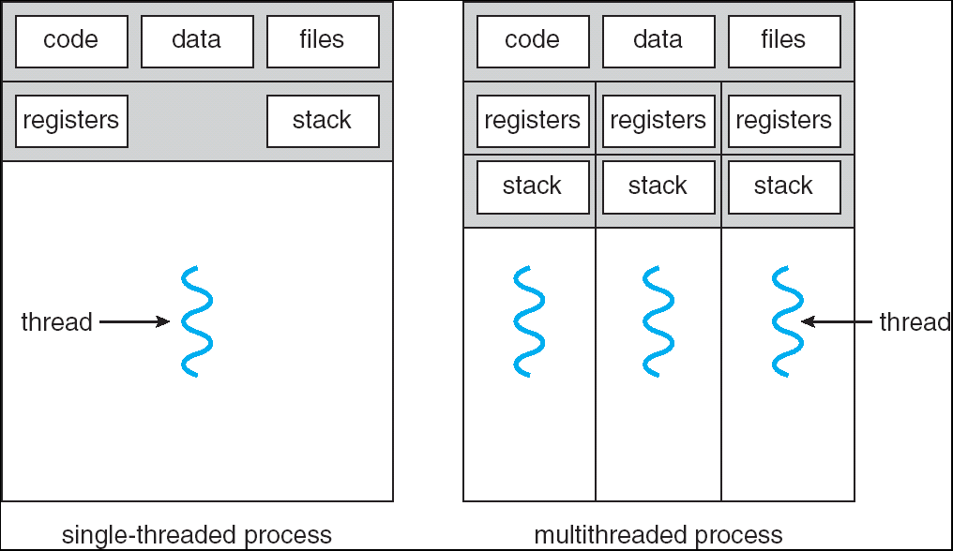
Single and Multithreaded Processes
Threads encapsulate concurrency: “active” component
Processes (address spaces) encapsulate memory protection: “passive” component
Each process should have at least one thread (at least one main() as the entry point of thread execution)
Notes:
Sometimes need parallelism for a single job, and processes are very expensive – to start, switch between, and to communicate between Keeps buggy programs from crashing the system

Slide 15
Address Space of a 2-Threaded Process
It has two stacks
Must make sure that the stacks and heap do not grow into each other, causing stack overflow
Stack 1
Stack 2
Address Space
Heap
Global Data
Code
Notes:
Process crash
Insert guard page

Slide 16
Classification
One
Many
# of processes:
# threads
Per process:
One
MS/DOS, early Macintosh
Traditional UNIX
Many
Embedded systems (QNX, VxWorks,etc)
Mach, OS/2, Linux
Win NT,XP,7, Solaris, HP-UX, OS X
Virtual memory mechanism requires HW support (Memory Management Unit) that may not be available in small embedded processors, hence embedded systems are often single-process
Notes:
Real operating systems have either
One or many address spaces
One or many threads per address space

Slide 17
Traditional UNIX Process
Each process has a single thread of execution
Called a “heavy-weight process”
Similar to Thread Control Block, each process has a Process Control Block (PCB) that holds the process-related context.

Slide 18
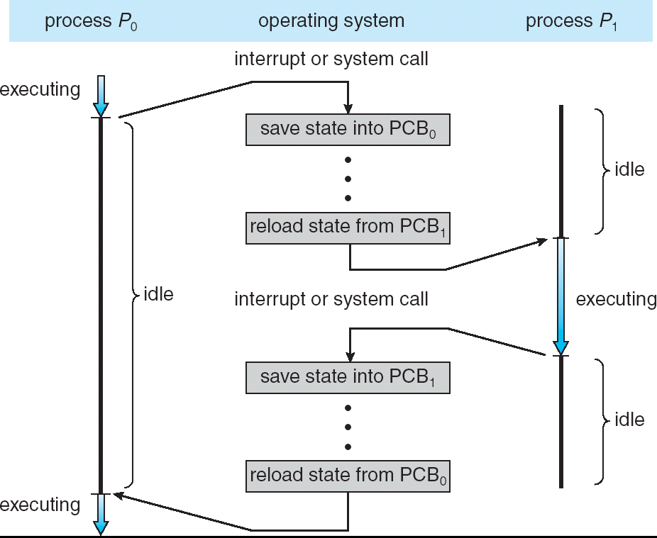
CPU Switch between Processes
Process context-switch has relatively large overhead (compared to thread context-switch), since it involves manipulating the page table and copying memory
(Thread context-switch is similar, by replacing PCB with TCB.)

Slide 19
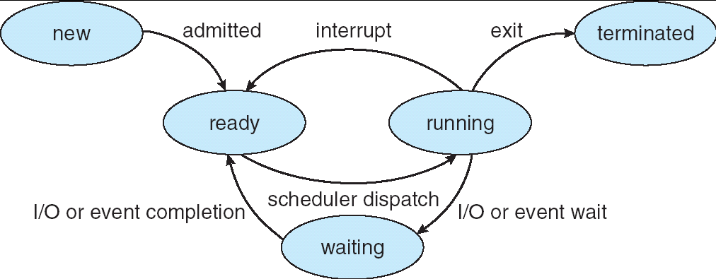
Process State Machine
As a process executes, it changes state
new: The process is being created
ready: The process is waiting to run
running: Instructions are being executed
waiting: Process waiting for some event to occur
terminated: The process has finished execution
See animation
(This state machine also applies to threads)

Slide 20
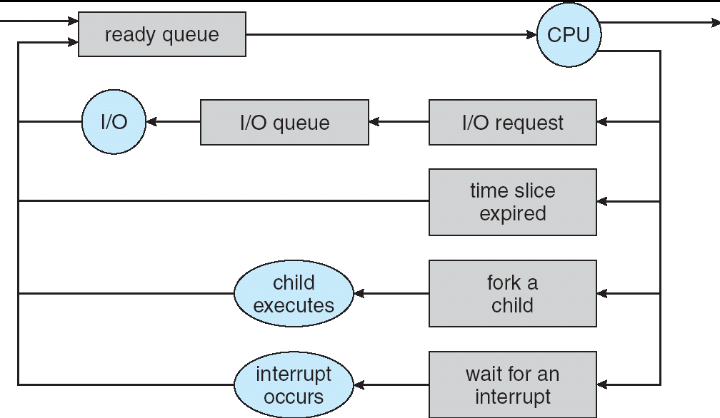
Process Scheduling
Processes (in actual implementation, their PCBs) move from queue to queue as they change state
Many scheduling algorithms possible
(also applies to threads, with TCBs instead of PCBs)

Slide 21
Motivation for Multi-Threading
Why have multiple threads per process?
May need concurrency for a single application, and processes are very expensive – to start, switch between, and to communicate between
Communication between processes is not as convenient as between threads in the same process

Slide 22
What Does it Take to Create a Process?
Must construct new PCB
Inexpensive
Must set up new page tables for address space
More expensive
Copy data from parent process (Unix fork() )
Semantics of Unix fork() are that the child process gets a complete copy of the parent memory and I/O state
Originally very expensive
Much less expensive with “copy-on-write” (initially shared; make a copy only when an address is written to)
Copy I/O state (file handles, etc)

Slide 23
Multiple Processes Collaborate on a Task
Proc 1
Proc 2
Proc 3
High Creation/memory Overhead
(Relatively) High Context-Switch Overhead
Need Communication mechanism:
Separate Address Spaces Isolates Processes
Shared-Memory Mapping
Mapping virtual addresses to common physical address
Read and Write through memory
Message Passing
send() and receive() messages
Works either locally or across a network
Notes:
Collaboration allows faults to propagate…

Slide 24
Shared Memory Communication
Data 2
Code
Data
Heap
Stack
Shared
Stack
Heap
Data
Code
Code1
Data1
Stack 1
Stack 2
Shared
Heap1
Proc 1
Virtual
Address
Space 1
Proc 2
Virtual
Address
Space 2
Heap 2
Code 2
Shared
Communication occurs by reading/writing to shared address page
Establishing shared memory involves manipulating the translation map, hence can be expensive
Notes:
Low overhead communication
Introduces complex synchronization problems

Slide 25
Message-Based Inter-Process Communication (IPC)
Mechanism for processes to communicate with each other without shared memory
IPC facility provides two operations:
send(message) – message size fixed or variable
receive(message)
If P and Q wish to communicate, they need to:
establish a communication link between them
exchange messages via send/receive
Notes:
Message system – processes communicate with each other without resorting to shared variables

Slide 26
Modern UNIX Process
Multithreading: a single process consists of multiple concurrent threads
A thread is sometimes called a “Lightweight process”
Thread creation and context-switch are much more efficient than process creation and context-switch
Inter-thread communication is via shared memory, since threads in the same process share the same address space

Slide 27
A Single-Threaded Program
Consider the following C program: main() {
ComputePI(“pi.txt”);
PrintClassList(“clist.text”);
}
What is the behavior here?
Program would never print out class list
Why? ComputePI would never finish

Slide 28
Use of Threads
Version of program with Threads:
main() {
CreateThread(ComputePI(“pi.txt”));
CreateThread(PrintClassList(“clist.text”));
}
“CreateThread” starts independent threads running given procedure name

Slide 29
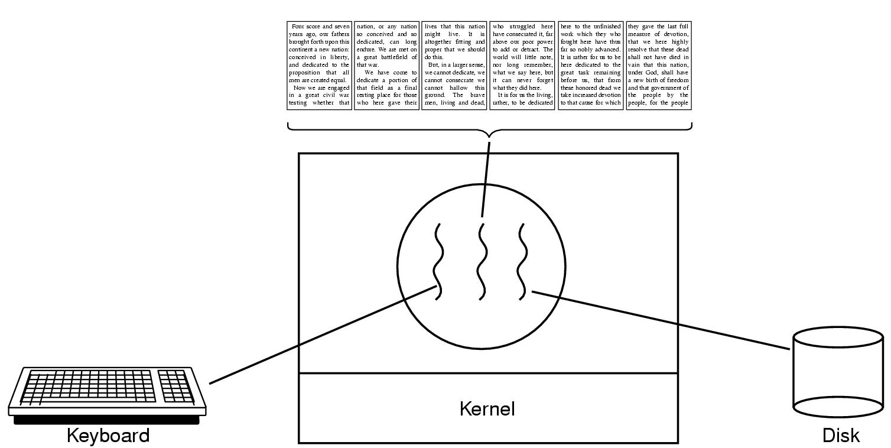
Example: a Multi-Threaded Text Editor
One thread for handling keyboard input; one for handling graphical user interface; one for handling disk IO
3 threads must collaborate closely and share data

Slide 30
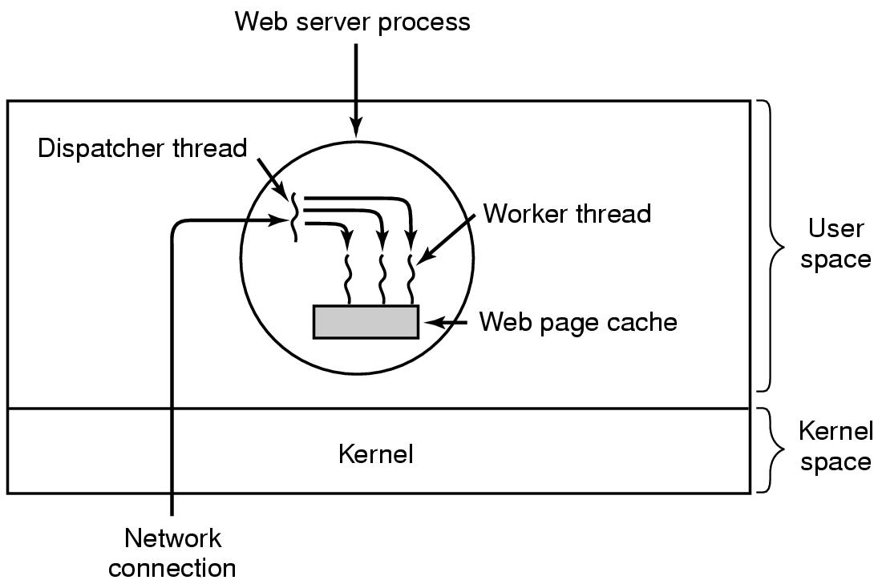
Example: a Multi-Threaded Database Server

Slide 31
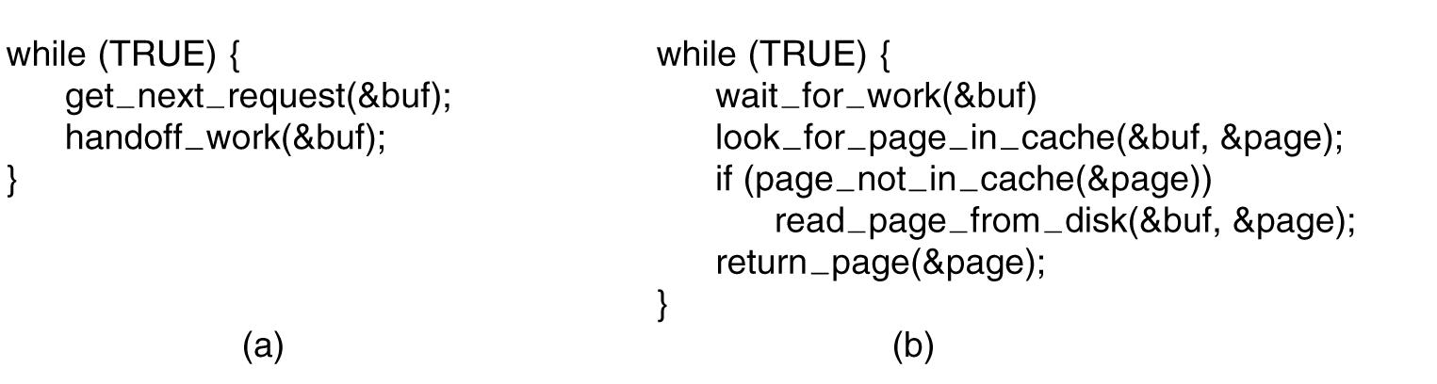
Database Server Implementation
(a) Dispatcher thread. (b) Worker thread.
A single dispatcher thread hands off work to a fixed-size pool of worker threads.
The alternative of spawning a new thread for each request may result in an unbounded number of threads; it also incurs thread creation overhead for each request.
By creating a fixed-size pool of threads at system initialization time, these problems are avoided.

Slide 32
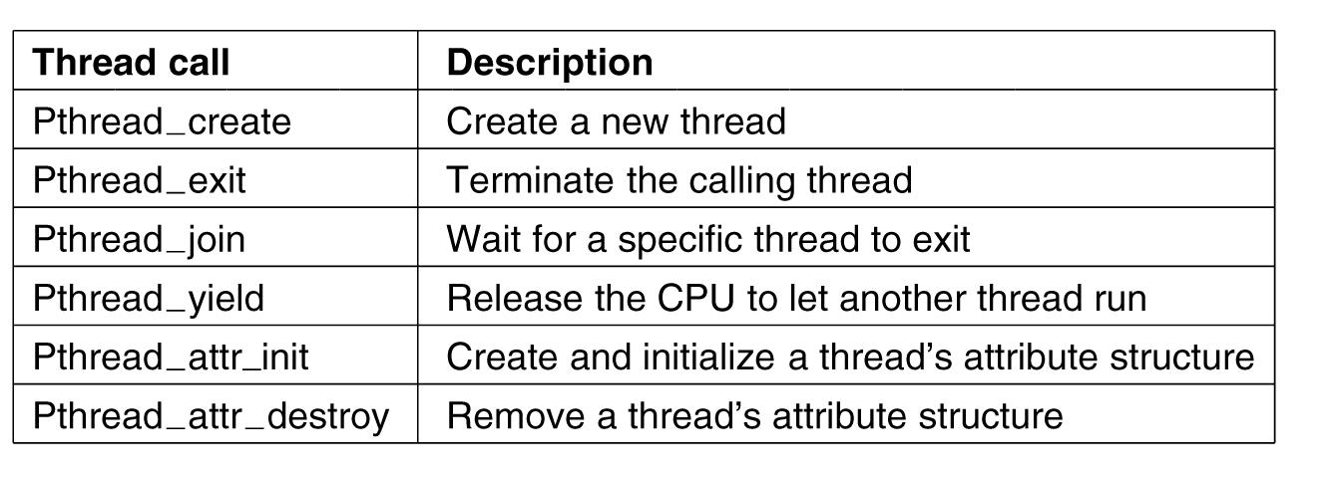
POSIX Thread API
POSIX (Portable Operating System Interface for Unix) is a family of related standards specified by the IEEE to define the API for software compatible with variants of the Unix operating system,

Slide 33
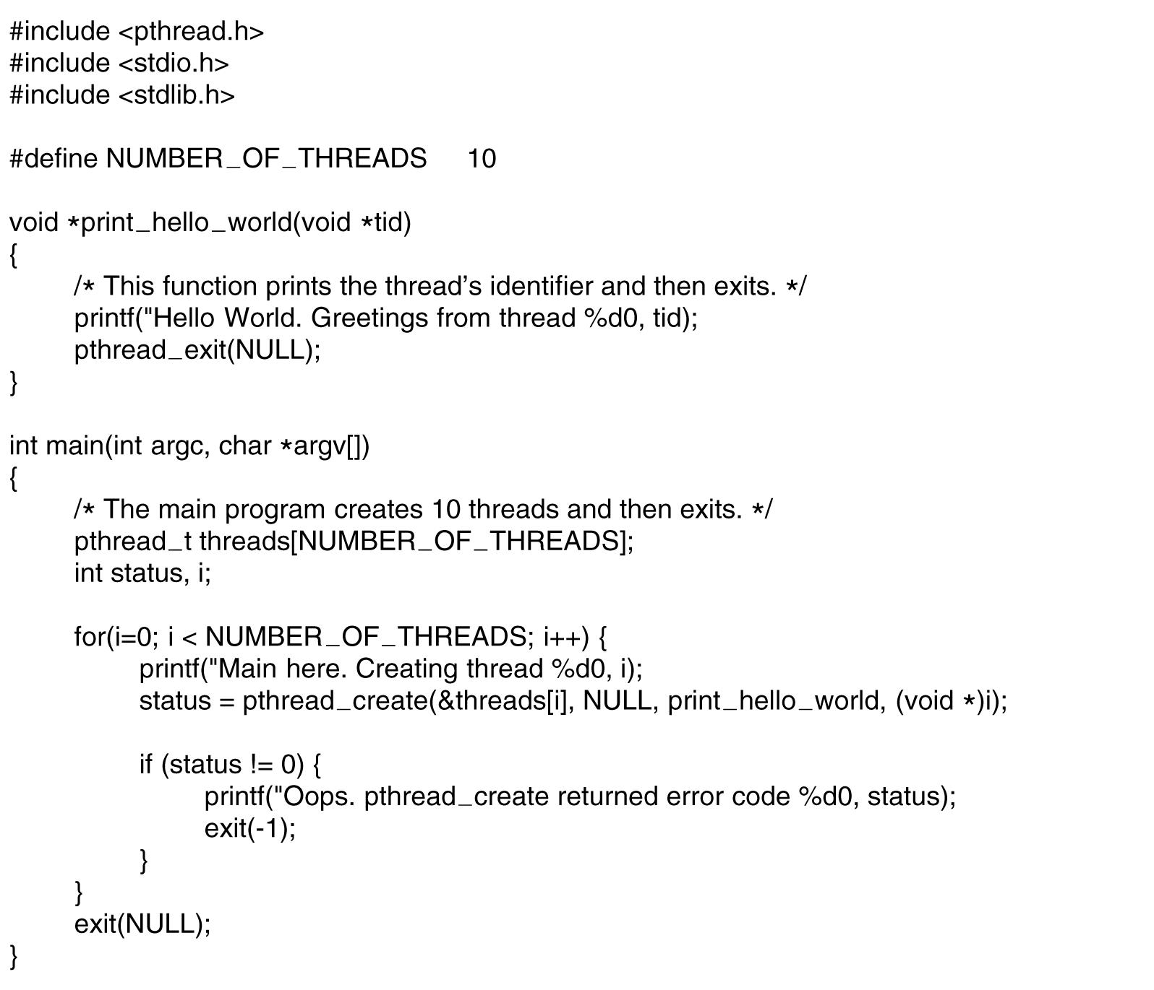
A Multithreaded POSIX Program
What is the output of this program?
Depends on the OS scheduling algorithm
Likely prints out thread IDs in sequence

Slide 34
Summary
Processes have two aspects
Threads (Concurrency)
Address Spaces (Protection)
Concurrency accomplished by multiplexing CPU Time:
Such context switching may be voluntary (yield(), I/O operations) or involuntary (timer, other interrupts)
Save and restore of either PCB (Process Control Block) when switching processes, or TCB (Thread Control Block) when switching threads
Protection accomplished restricting access:
Virtual Memory mapping isolates processes from each other
When we talk about processes
When this concerns concurrency, really talking about thread aspect of a process
When this concerns protection, talking about address space aspect of a process

